Slide 1
SSP Conference 2020

Slide 2
Welcome!
SSP Conference 2020

Slide 3
Our History
2009 – 2013 Foundation
2013 - 2016 External interfaces
2016 – 2019 Work Automation
2019-2021 Future
Self Service Front-End
HP ServiceDesk
Workflow engine
Generic Adapter
Ticketing
Service Catalog
Word adapter
Knowledge Management
Meeting rooms
Custom apps
Release Manager
Move apps to the cloud
Governance
UX
Surfing the wave of Digital transformation
Innovative new apps

Slide 4
Objectives
It’s your conference – meet and learn
SMTX development sharing
Customer experiences
Drink some beer

Slide 5
SMTX Today
Where do we stand?

Slide 6
Agenda

Slide 7
Who is here?
Let’s introduce

Slide 8
Tuesday
9.00 – 9.30 : Welcome Wagon
9.30 – 10.00 : Continental (Matthias Federmann)
10.00 – 10.30 : UZ Gent (Joeri Meeus)
10.30 – 10.45 : Coffee Break
10.45 – 11.00 : New features & UI (Raymond Crijnen)
11.00 – 11.30 : Foreign Affairs (Thierry Legrand)
11.35 – 12.00 : Word Adapter (Dominic De Vilder)
12.00 – 13.00 : Lunch

Slide 9
Tuesday
13.00 – 13.30 : Release Manager (Raymond Crijnen)
13.30 – 14.00 : BG Phoenic (Joerg Buscher)
14.00 – 14.30 : Generic Process (Raymond Crijnen)
14.30 – 14.45 : Coffee Break
14.45 – 17.00 : SSP 2020
18.00 : Apéritif
19.30 : Dinner @ Pakhuis

Slide 10
Wednesday
8.30 – 9.00 : Welcome Coffee
9.00 – 9.20 : Service Catalog (Dominic De Vilder)
9.20 – 9.50 : Continental (Benedikt Lautenschlager)
9.50 – 10.10 : New Features – Technical Session (Raymond Crijnen)
10.10 – 10.25 : Coffee Break
10.25 – 11.10 : UZ Gent (Joeri Meeus)
11.10 – 11.40 : New features – to go beyond (SMTX)
11.40 – 12.10 : New features – Ticketing (Raymond)
12.00 – 13.00 : Lunch + Beer tasting
13.00 - … : SSP Café & closure

Slide 11
The drop-outs
Nomura
Honeywell
RDW
Fujitsu
Proximus
s.Oliver
CESES
DSTO
Valid Solutions
Partner channel
ATOS
Siemens
Fujitsu
PNH
Rotterdam Harbour
ITC Germany
Stadt Köln
LDI
IBB
Hannover Re

Slide 12
Siemens
Setup
Stand-alone, workflow handled tickets
Variety of about 100 processes
4 different instances (Spain, France, Belgium and SWE Europe)
Challenges
ATOS maintenance
Knowledge Transfer
Merge 4 environments
SAP Integration

Slide 13
Nomura
Setup
Stand-alone workflow management tool
Ticketing module
Key Features
Invoice Management
Risk assessments
Standard solution for automation of non-IT workflows
ServiceNow integration planned

Slide 14
Honeywell
Setup
Stand-alone, workflow handled tickets
Key Features
Meeting room reservations
DocuSign
Asset Management through MyItems

Slide 15
RDW
Setup
Front end Self Service for Microsoft Service Center
Managed environment
ServiceNow integration Fujitsu
Key Features
Shopping basket in forms
JSON data manipulations / REST webservices

Slide 16
Proximus
Setup
Self Service Front-end
Connected to HP Service Manager
Single main form with 500 sub-forms
Challenges
New ITSM solution
Roll-out to partner channel

Slide 17
s.Oliver
Setup
Stand-alone
Lots of integrations
LDAP, powershell scripts, local systems
Advanced CSS updates
Specialties
Generic Process

Slide 18
Present today
UZ Gent
Continental
Foreign Affairs The Netherlands
Synergics
Kind en Gezin

Slide 19
Kind en Gezin
Setup
Self Service Front-end
Prolin / HP Openview Service Desk
Challenges
Federated authentication

Slide 20
Synergics
Setup
Self Service Front-end
Omnitracker as back-end solution

Slide 21
Valid Solutions
Setup
Self Service Front-end
Omnitracker as back-end solution
Challenges
Custom forms per customer
Security
Simplified maintenance

Slide 22
Key numbers
 | 2015 | 2019 | 2021
Ticketing | 0% | 33% | 60%
Workflow engine usage | 80% | 90% | 90%
Stand-alone setup | 20% | 40% | 70%
External web service connectors | 25% | 80% | 100%
Hosted / Cloud | 5% | 20% | 50%
Lost to the dark side | 1 | 1 | 0

Slide 23
Continental
Matthias Federmann

Slide 24
UZ Gent
Joeri Meeus

Slide 25
Custom UI
1
Building a custom UI layer on top of SSP API

Slide 26
User Interface API
Custom developed UI
API
layer
SSP Server

Slide 28
Custom UI
Benefits
Lightning fast
Great user experience
Any design is possible
Limitations
Data is limited to what the API can provide
Maintenance at own costs

Slide 29
Project approach
1.
Ideal design
2.
Mockup in HTML
3.
Add code behind HTML
4.
Redirect all URL
Approx. Costs: € 15.000

Slide 30
Ministery of Foreign Affairs
Thierry le Grand

Slide 31
MS Word Adapter
2
Generate DOCX and PDF through the Content Management Module

Slide 32
Building Blocks
Snippits
Word Templates
Publication
Process
Snippits
Re-Usable Content
Auto-detect keywords
Word Templates
Auto-detect keywords
Publication
Approval flow
Process
New Step Type
Conditions

Slide 33
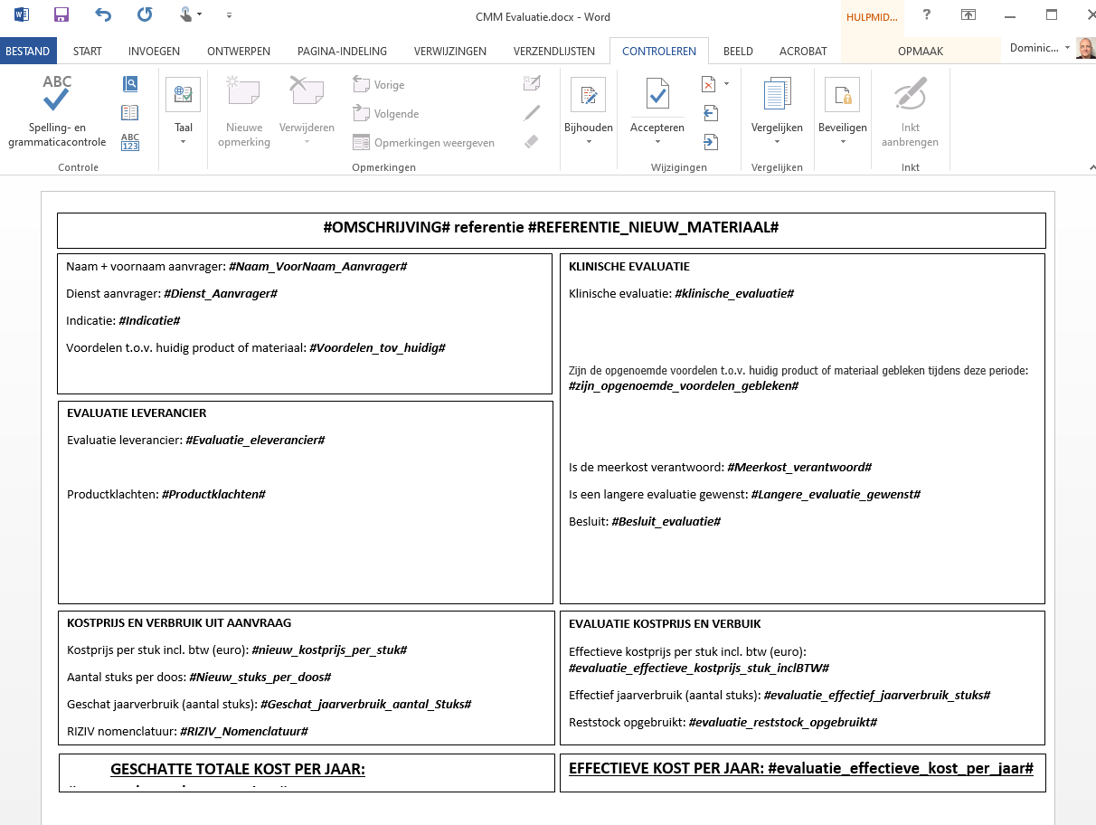

Slide 34
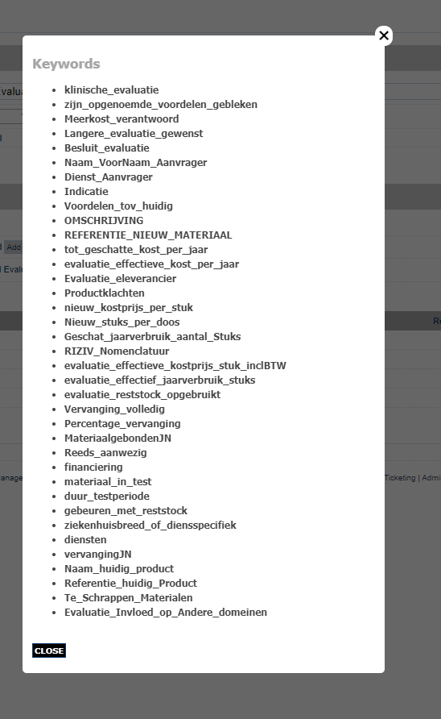

Slide 35
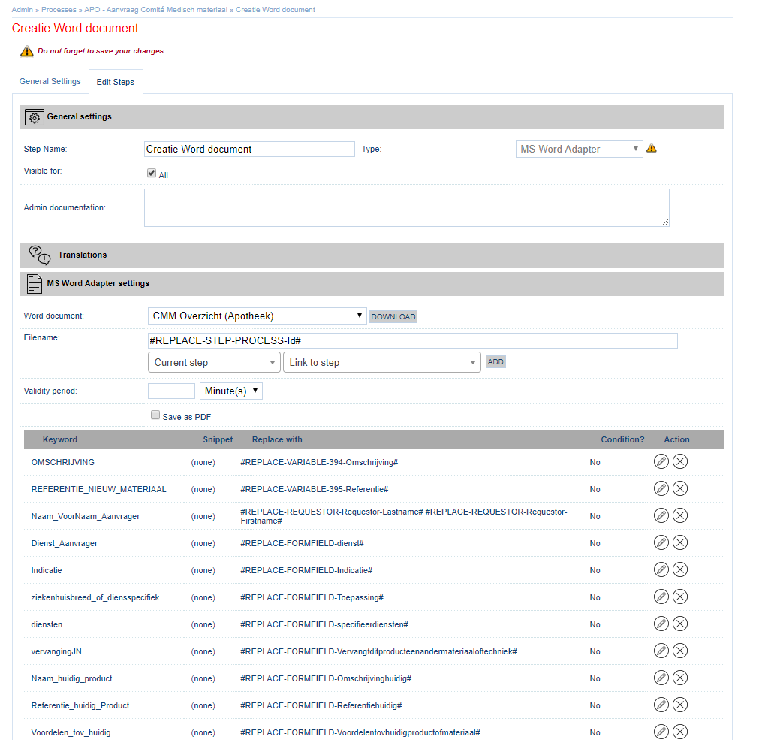
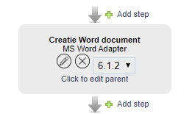

Slide 36
MS Word Adapter
Benefits
No HTML
Easy to learn
No Admin access or training
Usage tracking
Version control
Complete manual
Limitations
File is generated when step is started
No Excel files
Limit to 1 condition

Slide 37
Release Management
3
Transport configurations through environments

Slide 38
Release Management
Development
Acceptance
Production
Release Package
Forms
Processes
Datastores
Web Services
Import
Forms – Retire
Processes – Retire
Datastores – Add/Remove
Web Services – Add/Remove
Import
Forms – Retire
Processes – Retire
Datastores – Add/Remove
Web Services – Add/Remove

Slide 39
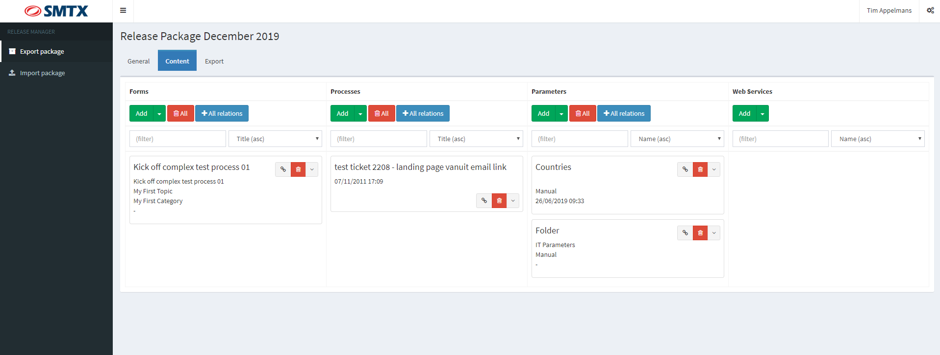
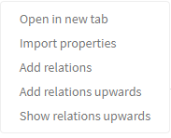

Slide 41
Release Manager
Benefits
Export multiple elements in 1 file
Retire old versions
Review and test old versions
Datastore replacement, option to keep data

Slide 42
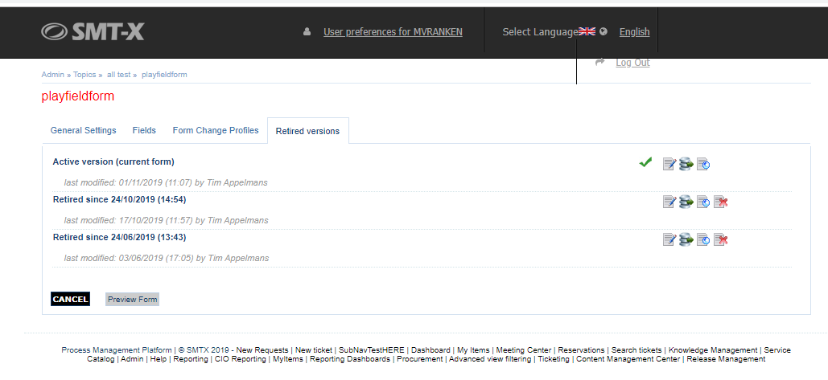
Retired versions
Active Forms / Process
Retired version 1
Retired version 2
Retired version 3

Slide 43
Importing
Form Version 1
Process Version 1
link
Form version 2
Form version 2
Process Version 1
Import
link
Version 1

Slide 44
Importing
Form Version 1
Datastore parameter
link
Datastore parameter
New id
Manual data saved
Datastore parameter
Form version 2
Form version 2
Datastore parameter
Import
link
Datastore parameter
Datastore parameter
Version 1
Datastore parameter

Slide 46
Import checks
Warning
Datastore parameter fields
Webservice fields
References to non-existing ticketing custom fields
Roles that refer directly to the form are not found (searched on name)
Information
Item was not found and a new form is added

Slide 47
Licensing
Additional module
No user restrictions

Slide 48
BG Phoenics
Joerg Buscher

Slide 49
Generic Process

Slide 51
Your vision on the future
2020
Round table session

Slide 52
SSP 2020
Enhanced Security
Ticket Flushing
Low level admin
New UI
Cloud
Stand alone components
Service Catalog

Slide 53
Service Catalog
4
Starting point for Service Management

Slide 54
Service Catalog
2015 : Idea was born
Organize & visualize everything IT does
Chart out relations : dependency & costs
2017 : Development
Hierarchical data model
Administration
Front-End trials
2019 : Launch
Continental
Finetune Administration
Connection to BMC

Slide 55
Service Catalog
Templates
Services
Support Groups

Slide 56
Service Catalogue
Goals
Receivers
Providers
Outages
Footer text

Slide 57
Current issues
Delivery
Demand
IT Services
No business value focus
Technology oriented reporting
Service costs justification
Service delivery chains unknown
Service Catalog is a dusty and corrupt document
Strategic data is missing
Critical services for business value unclear
Creation of shadow IT
Service contracts unknown
Notes:
Although the importance of matching demand to delivery is obvious, many organizations still have trouble getting the right information to the decision makers involved.
At Delivery side, reporting is rarely based on the business value of the provided services, and often technology oriented. Costs associated to services can’t be justified properly as the link to demand management is not clear. Knowing who and what are involved in service chains , under which conditions, isn’t always available as desired. If existing the service catalog is a dusty text file containing outdated information and is not easily accessible.
From the perspective of demand management, people often are not aware how IT systems are organized, why they are so expensive and how they perform. Which services are required to keep critical business processes alive and do they have the right service level for that? Another aspect that is seen as a result of new cloud services is shadow IT. Business users contract cloud service providers directly, without involving IT. Competitors or innovation create new demands and new technologies should be adopted, how easily can this be done and requested.

Slide 58
Current Toolset
Service Delivery Organization
Service Demand Organization
Very operational focus
Ticketing tooling
Network discovery
Identity Management
Mobile Device Management
Operational reporting
…
Service Delivery
Service Customers
Notes:
Now, what is causing these issues and how can we deal with them.
Looking at the current toolset of IT organizations, there are many tools available to automate and measure operational processes. There are ticketing tools, network discovery solutions, identity management and access control systems, mobile device management platforms and most of them provide technical oriented reporting. There doesn’t seem to be a bundling of all this data to inform higher level management.

Slide 59
Manage on business value
Service Delivery Organization
Service Demand Organization
Very operational focus
Do we cover business process needs?
Do we have the right SLA ?
Should a service be outsourced?
Risks in service chains?
Customer satisfaction?
What-if-analysis?
Service Delivery Management
Demand Management
Reporting
Wishes
Targets
Solutions
Service Delivery
Service Customers
Notes:
Now, what is causing these issues and how can we deal with them.
Looking at the current toolset of IT organizations, there are many tools available to automate and measure operational processes. There are ticketing tools, network discovery solutions, identity management and access control systems, mobile device management platforms and most of them provide technical oriented reporting. There doesn’t seem to be a bundling of all this data to inform higher level management.

Slide 60
Open Questions
Service Delivery Organization
C-Level
C-Level
Service Demand Organization
Business continuity assurance?
Cost cutting possibilities?
Security demands and threads ?
Service costs build-up?
Vendor dependency?
Vulnerabilities?
Reporting
Reporting
Strategy
Strategy
Service Delivery Management
Demand Management
Reporting
Wishes
Targets
Solutions
Service Delivery
Service Customers
Notes:
Now, what is causing these issues and how can we deal with them.
Looking at the current toolset of IT organizations, there are many tools available to automate and measure operational processes. There are ticketing tools, network discovery solutions, identity management and access control systems, mobile device management platforms and most of them provide technical oriented reporting. There doesn’t seem to be a bundling of all this data to inform higher level management.

Slide 61
Solve these issues
Service Delivery Organization
C-Level
C-Level
Service Demand Organization
Reporting
Reporting
Strategy
Strategy
Service Catalog
By making your Service Catalog the cornerstone of Service Management and Service Communication.
Service Delivery Management
Demand Management
Reporting
Wishes
Targets
Solutions
Service Delivery
Service Customers
Notes:
Now, what is causing these issues and how can we deal with them.
Looking at the current toolset of IT organizations, there are many tools available to automate and measure operational processes. There are ticketing tools, network discovery solutions, identity management and access control systems, mobile device management platforms and most of them provide technical oriented reporting. There doesn’t seem to be a bundling of all this data to inform higher level management.

Slide 62
SMTX Service Catalogue
Service Delivery Organization
C-Level
C-Level
Service Demand Organization
Enabling organizations to
Communication platform
Better match services to business needs
Service communication platform
Business value visualization
Reporting
Published service data
Service performance
Service Catalog
Service Delivery Management
Demand Management
Service Delivery
Service Customers
Notes:
Now, what is causing these issues and how can we deal with them.
Looking at the current toolset of IT organizations, there are many tools available to automate and measure operational processes. There are ticketing tools, network discovery solutions, identity management and access control systems, mobile device management platforms and most of them provide technical oriented reporting. There doesn’t seem to be a bundling of all this data to inform higher level management.

Slide 63
Continental
Benedikt Lautenschlager

Slide 64
Technical Session
5
Webhooks + External apps
NCALC
ADF (Datastore Feeder)
Scrubber
Type-ahead

Slide 65
Webhooks
Key features
Receive triggers from external systems
Custom workflows per trigger

Slide 66
Webhooks
XSLT
Process
data
External system
Webhook 1
Process
../WebHooks/Incoming.ashx?smtx[key]=secrettoken&smtx[entry]=webhook1
data
Process
XSLT
data
External system
Webhook 2
Process
data
../WebHooks/Incoming.ashx?smtx[key]=secrettoken&smtx[entry]=webhook2

Slide 67
NCALC
Key features
Complex calculations
Keep your eyes on wiki.smt-x.com
Placeholders
#REPLACE-FORMFIELD-Name#
#REPLACENCALC-FORMFIELD-Name#
#REPLACEPLAIN-FORMFIELD-Name#

Slide 68
ADF – Datastore Feeder
Key features
Import Data from Excel automatically
Define location, interval & post-import events

Slide 69
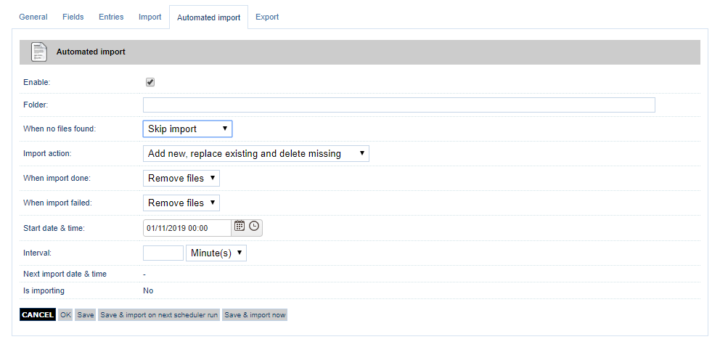

Slide 70
Scrubber
Key features
Run checks on datastore parameters
Find expired elements, contracts to renew, …

Slide 71
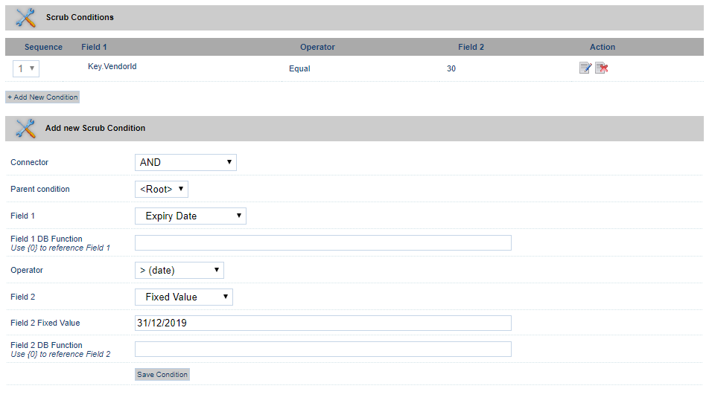

Slide 72
Type-Ahead
Key features
New form field type
Users can search lists quicker
Avoid seperate search box

Slide 73
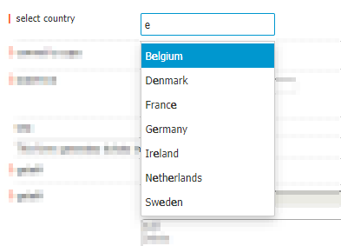
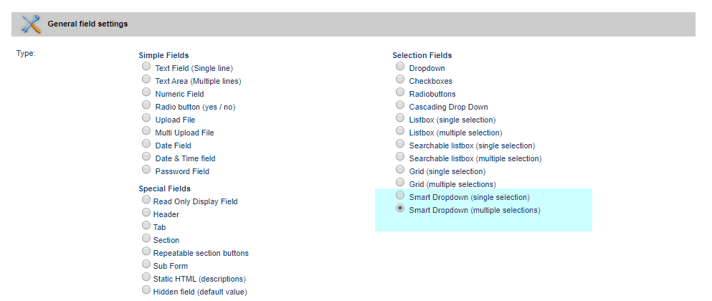

Slide 74
UZ Gent
Joeri Meeus

Slide 75
To go beyond
6
Small unknown elements of SSP

Slide 76
Workflow pools
Process Instances table
Pool A
Pool B
Pool C
Ticket Type A
Ticket type A
Ticket Type B
Ticket Type A
Ticket Type B
Ticket Type C
Ticket type A
Ticket Type C
Ticket type A
Ticket Type B
Ticket Type C
Ticket Type B
Ticket Type C
Ticket type A

Slide 77
Workflow Pools
Key features
Replaces existing functionality “same as person property”
Much faster data lookup
Secure and flexible
Same pools as for ticketing
Available in update ticket step

Slide 78
Features
Datastore webservice
Mobile component
Automated reports
GoTo Links
Knowledge Management
Overview layouts
Auto forms
Save File step
JSON functions
Repeating sections
Grid
Wiki
Members of group
Added / removed items

Slide 79
Ticketing
7
Manual processing of work

Slide 80
Ticketing
Work
Work
Work
SMTX Process Management Platform
Integrations
SOAP Services
REST Services
SQL Queries
Powershell scripts
File distribution
Automation
Manual Processing
Ticketing
Team Assignment
E-Mail integration
Tasks
External assignments
Search
Agent access

Slide 81
Ticketing
Tasks
Mature solution
Workflow integration
Ticketing Module
Access Rights
Views
Messages

Slide 82
Productivity Apps
IT
Loaner equipment
Time and attendance
Travel Requests
Internal audits
Patent tracking
Skill Management
Customer
Discount approvals
Call center scores
Customer feedback
Warranty claims
Contract Management
Lease creation
Employee
Visitor registration
Vacation requests
Employee feedback
Mobility
Rewards
Recruiting process

Slide 83
Why ticketing?
1
2
3
Workflow & integrations
Low code
Insights

Slide 85
Ticketing demo
Ticket creation
Messaging
Views
Tasks

Slide 86
SSP Cafe
8
Lets define the future together

Slide 87
What to do
Feedback
Dig deeper into specific topics
Share experiences
SSP 2020 Continued

Slide 89
Cloud GDPR
One stop shop to maintain dataflows, leaks, DPIA’s, …
Using state-of-the-art technologies
Subscription-based

Slide 90
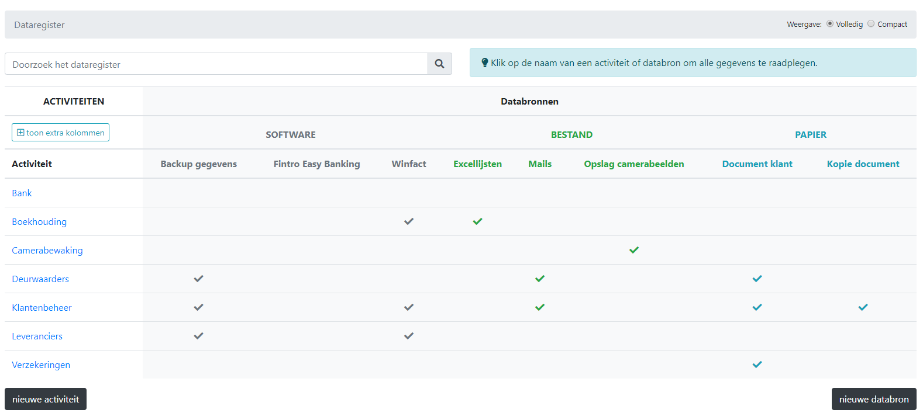

Slide 91
Thank you for joining us
SSP Conference 2020
Gent, Belgium
5 – 6 Nov 2019

